Slide 1
Security Evaluation Methods
Lecture 5
Asad Raza
asadraaza@gmail.com

Slide 2
Readings
Chapter 5 : CISSP
Chapter 9- Dieter Gollman

Slide 3
Assurance Ratings
Evaluation criteria is used to test the assurance and functionality of a product.
The assurance ratings work as a common language for customers to understand and use.
The vendors build to specifications within the limits of the criteria.
Different assurance ratings have different specifications that must be met.
The criteria rates trust and assurance.
Assurance: Level of confidence in the predictability and protection level provided in all situations.

Slide 4
Trusted Computer System Evaluation Criteria (TCSEC): The Orange Book
The Orange Book was developed by the National Computer Security Center (NCSC).
The Orange Book is based on the Bell-LaPadula model.
It uses a graded classification of systems that is developed into hierarchical security levels.
The A assurance rating: Verified Protection
The B assurance rating: Mandatory Protection
The C assurance rating: Discretionary Protection
The D assurance rating: Minimal Protection

Slide 5
The Orange Book
The rating system uses letters and numbers to indicate the assurance level that is provided.
Each assurance rating must meet a long list of expectations before the rating is achieved.
The criteria includes four main topics
Security Policy
Accountability
Assurance
Documentation

Slide 6
The Orange Book
C1: Discretionary Security Protection
Based on individuals/groups
Requires separation of user and information
Identification and authentication of individual entities
Requires design documents , test documents , facility manual
Trusted environment with low security concerns
C2: Controlled Access Protection
More precise access control and auditing functionality
Resource / object isolation
Object reuse concept must be invoked
Requires strict logon and decision making capabilities
Accountability is required
Most of the major vendors offer C2 evaluated versions

Slide 7
The Orange Book
B: Mandatory Protection
MAC is enforced by using security labels
Based on BLP model
Evidence of Reference monitor enforcement
B1: Labeled Security
Each object must have a classification label and subject must have a clearance level
Labels of objects and subjects are compared
Design specifications are reviewed and verified
This rating is intended for environments that’s requires the system to handle classified data
Design documentation, source code and object code are analyzed

Slide 8
The Orange Book
B2: Structured protection
Security policy is clearly defined and documented
Trusted path: Ensuring direct communication with an application or operating system.
Several types of attacks have circumvented communication with operating system components.
For a system to achieve B2 rating, there must be no way to interrupt these communication paths.
Distinct address space must be used for process isolation
Covert channel analysis should be conducted
This type of rating is intended for environment in which systems are resistant to penetration and compromise

Slide 9
The Orange Book
B3: Security Domains
More granularity in each protection mechanism
Unnecessary programming code is excluded
Design and implementation should not be complex
Security administrator defined
Automatic warnings in suspicious situations
Trusted recovery: A system can shut down and fail securely.
A system is very vulnerable when it has failed, but it still needs to stay in a secure state.
Operating system and its components should be loaded in a secure state
This rating is for the environment in which very sensitive information is processed

Slide 10
The Orange Book
A: Verified Protection
Formal methods are used to ensure that subjects and objects are controlled with discretionary or MAC.
A1: Verified design
Architecture and protection features are not much different from B3 rating
Assurance is higher than B3 because of the formality in which A1 system was designed
Formal techniques are used to prove equivalence between TCB specifications and security policy model
This rating is for environments which deals with top secret info
Only few products have achieved A1 rating including Blacker

Slide 11
Rainbow Series
The Orange Book was developed around 80's.
The Orange Book only looks at the operating system and not other issues like networking, databases etc.
The Orange Book focuses confidentially but not integrity and availability
The Orange Book works with government classifications, not industrial classifications.
The Orange Book has a small number of ratings, and many aspects of security are not evaluated and rated.

Slide 12
Rainbow Series
More books were written to extend the coverage of the Orange Book into other areas of security.
These books interpret certain Orange Book requirements and describe the evaluation processes.
Trusted Network Interpretation (TNI) also called the Red Book addresses security evaluation topics for networks and network components .
Red book addresses the following security requirements
Authentication , Message integrity , Non Repudiation , DOS, Data confidentiality , Network management , selective routing etc

Slide 13
ITSEC: Information Technology Security Evaluation Criteria
Adopted by European countries
ITSEC was the first attempt to establish a single standard for evaluating security attributes.
The two main attributes of a system evaluated under ITSEC: Functionality and Assurance.
Functionality is evaluated to see if the system delivers what it says it delivers.
Assurance is more abstract than functionality and harder to test.
Assurance is confidence in a security component’s effectiveness and ability to perform consistently.

Slide 14
ITSEC
Security Functional Requirements
Identification and Authentication
Audit
Resource utilization
Trusted paths/channels
User data protection
Security Management
TOE access
Communications
Privacy
TOE security
Cryptographic support

Slide 15
ITSEC
Security Assurance Requirements
Guidance Documents and Manuals
Configuration Management
Vulnerability Assessment
Delivery and Operation
Life Cycle Support
Assurance Maintenance
Development
Testing

Slide 16
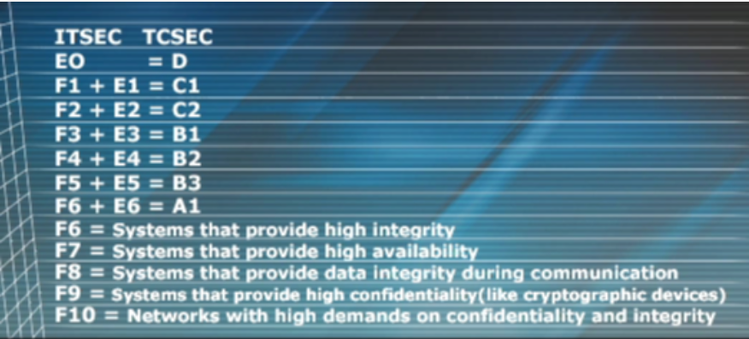
ITSEC

Slide 17
Common Criteria
The Common Criteria project was started to combine and align existing and emerging evaluation criteria.
TCSEC, ITSEC, Canadian Trusted Computer Product Evaluation Criteria (CTCPEC) and the Federal Criteria.
Collaboration of organizations in the United States, Canada, France, United Kingdom, Germany and Netherlands.
Having a worldwide recognized and accepted criteria helps reduce the complexity of the ratings.

Slide 18
Common Criteria Components
Protection Profile: Describes the objectives and the environmental, functional and assurance level expectations.
Target of Evaluation (TOE): Product proposed to provide the needed security solution.
Security Target: This is what the product does and how it does it
Written by vendor explaining mechanisms that meet security and assurance requirements.

Slide 19
Common Criteria
CC Assurance Ratings: Evaluation Assurance Levels (EALs)
Functional and assurance requirements are bundled into packages .
The EAL packages describe what must be met to achieve specific EAL ratings.
A product’s rating only applies to that particular version and only to certain configurations of the product.
A new version of the product that previously received an assurance rating does not inherit this rating.

Slide 20
Common Criteria
Evaluation Ratings
EAL 1 Functionally Tested
EAL 2 Structurally Tested
EAL 3 Methodically Tested
EAL 4 Methodically Designed, Tested and Reviewed
EAL 5 Semiformally Designed and Tested
EAL 6 Semiformally Verified, Designed and Tested
EAL 7 Formally Verified, Designed and Tested

Slide 21
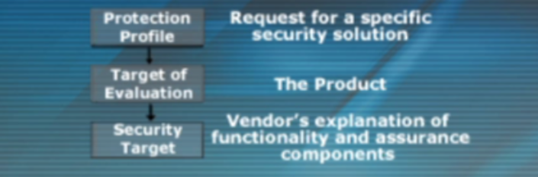
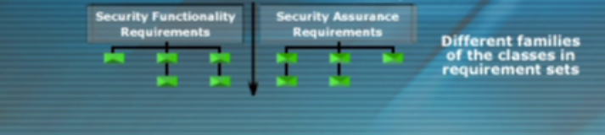
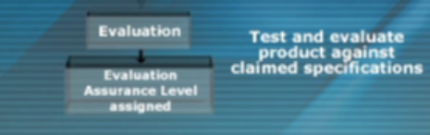
Common Criteria

Slide 22
Common Criteria
Product is put on an Evaluated Products List EPL, obtainable through the internet.

Slide 23
Certification and Accreditation
Certification: Comprehensive technical evaluation of the components’ compliance for accreditation.
Certification process: Evaluates risk analysis, safeguards, verification, testing, auditing techniques etc.
Accreditation: Formal acceptance of the adequacy of a system’s security and functionality by management.
Once satisfied with the system’s security, management makes a formal accreditation statement.

Slide 24
Common Threats
Covert Channels
Backdoors
Timing Attacks
Buffer Overflows

Slide 25
Covert Channels
Covert Channel: A way for an entity to receive information in an unauthorized way.
Loki Attack: Attacker inserts data into an ICMP packet, which is the data’s transport mechanism.
This information flow is not controlled by a security mechanism or the mechanism has been compromised.
This type of communication violated the security policy.
Notes:
LOKI is a client/server program published in the online publication Phrack. This program is a working proof-of-concept to demonstrate that data can be transmitted somewhat secretly across a network by hiding it in traffic that normally does not contain payloads. The example code can tunnel the equivalent of a Unix RCMD/RSH session in either ICMP echo request (ping) packets or UDP traffic to the DNS port. This is used as a back door into a Unix system after root access has been compromised. Presence of LOKI on a system is evidence that the system has been compromised in the past.
Remedy: If the LOKI attack is crossing a perimeter router or firewall, add a rule that blocks all ICMP traffic entering your network.
To determine if LOKI is running, look for programs that have an ICMP raw socket open. This can be done from a root shell on Linux with a command similar to: "netstat -a -n -w" If you see something like this:
Active Internet connections (including servers) Proto Recv-Q Send-Q Local Address Foreign Address State raw 0 0 0.0.0.0:1 0.0.0.0:* raw 0 0 0.0.0.0:1 0.0.0.0:* raw 0 0 0.0.0.0:255 0.0.0.0:*

Slide 26
Covert Channels
TCSEC defines two types of Covert Channels
Covert Storage Channel: A process writes data to a storage location and another process reads it.
Covert Timing Channel: One process sends data to another by modulating its use of system resources.
Modulation of system resources: Accessing hard drive, using excessive CPU cycles, or head placement.

Slide 27
Covert Channels
Overt Channel: A channel that was developed for communication.
Within an operating system, when subjects communicate legally they are using overt channels.

Slide 28
Backdoors
Different types of backdoors can allow unauthorized access into system.
Trojan horses insert backdoors into a system, allowing attackers in without authentication.
Maintenance Hooks: Instructions within software that only the developer knows about and can use.
The backdoor is usually initiated by a random sequence of keystrokes that provide access into the software.
Backdoors allow access without going through normal access control and security checks and mechanisms.

Slide 29
Asynchronous Attacks
Specific attacks can take advantage of the way a system processes request and performs tasks.
An asynchronous attack deals with the sequence of steps a system uses to complete a task.
TOC/TOU: An asynchronous attack that changes something between two sequences of the same task.
Notes:
A time-of-check-to-time-of-use bug (TOCTTOU − pronounced "TOCK too") is a software bug caused by changes in a system between the checking of a condition (such as a security credential) and the use of the results of that check. It is a kind of race condition.
A simple example is as follows: Consider a Web application that allows a user to edit pages, but allows administrators to lock pages to prevent editing. A user requests to edit a page, getting a form by which he can alter its content. Before the user submits the form, an administrator locks the page, which should prevent editing. However, since the user has already begun editing, when he submits the form, his edits are accepted. When the user began editing, his authorization was checked, and he was indeed allowed to edit. However, the authorization was used later, after he should no longer have been allowed.

Slide 30
Asynchronous Attacks
Two different processes carrying out their task on a resource must follow the correct sequence.
An attacker who manipulates process two into working first, controls the outcome of the processing procedure.
This attack deal with the sequence of steps processes use to carry out tasks, and is extremely hard to detect.
There are not many, if any, protection tools that look at these issues to this level of granularity.
It is best addressed during the development of the product.

Slide 31
Data Validation
When an application or operating system accepts data, it must make sure that it is the right type of data.
Many attacks have been successful because these checks were not carried out.
A simplistic but damaging attack that was caused by improper data validation was SQL Slammer.
This type of vulnerability is best addressed during the development of the software.

Slide 32
Buffer Overflow
Buffer overflow happens when programs do not check the length of the data that is inputted into a program.
This is sometimes referred to as smashing the stack.
A buffer overflow is usually aimed at systems that let the extra code execute with privileged rights.
A developer should implement proper bounds checking to eliminate buffer overflows.

